Slide 1


Teasing out the multi-scale representational space of cross-modal speech perception: Methods
Arpan Banerjee
Cognitive Brain Dynamics Lab

Slide 2
Overview
EEG/ MEG: Origins and signals
Key concepts: Times series and spectral estimates
Extracting functional and effective networks

Slide 3
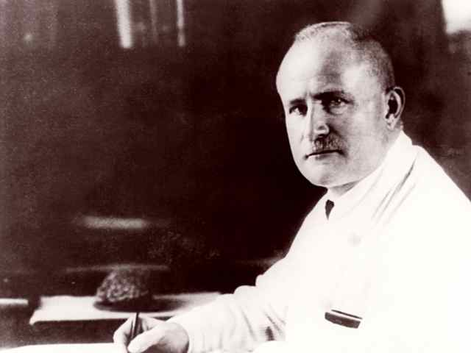
Hans Berger 1924 – The Dude

Slide 4
EEG
What is EEG
Almost 100 years of research.. No clear generator identified
What does EEG inform us?
Lot actually in terms of information processing during tasks,
segregation as well as integration measures, brain networks

Slide 5
What is EEG
Cohen TICS 2017

Slide 6
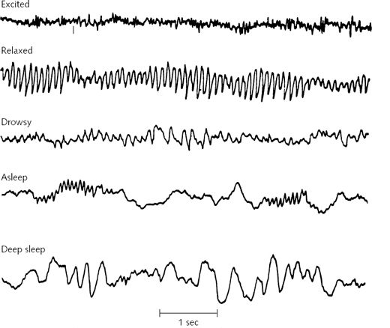
What do EEG tell us
Beta 16-25 Hz
Gamma > 25 Hz
Alpha 7-12 Hz
Theta 4-7 Hz
Delta < 4 Hz

Slide 7
What do EEG tell us

Slide 8
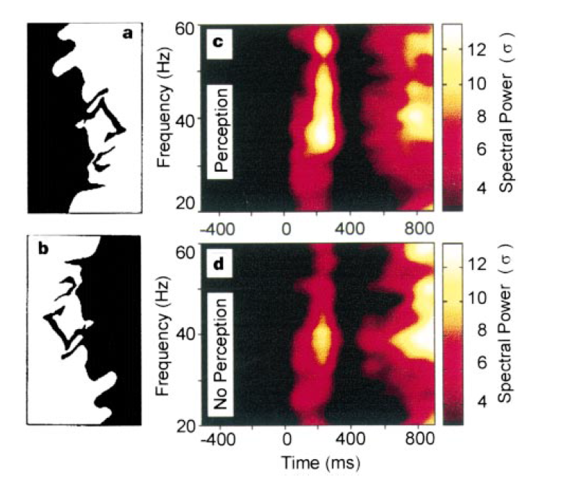
What do EEG tell us
Rodriguez et al 1999

Slide 9
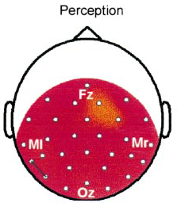
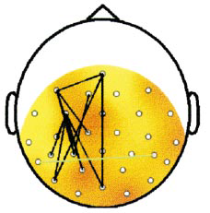
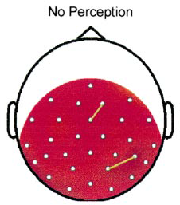
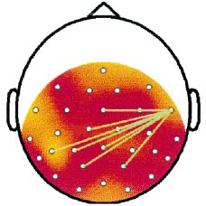
Why neurocognitive networks
0-180 ms
180 - 360 ms

Slide 10
What do EEG tell us
Traub et al 1996
Multiscale phenomena, Varella 2001

Slide 11
Key Concepts
Identifying events of information processing
Spectro-temporal structure of information processing
Source analysis: A primer

Slide 12
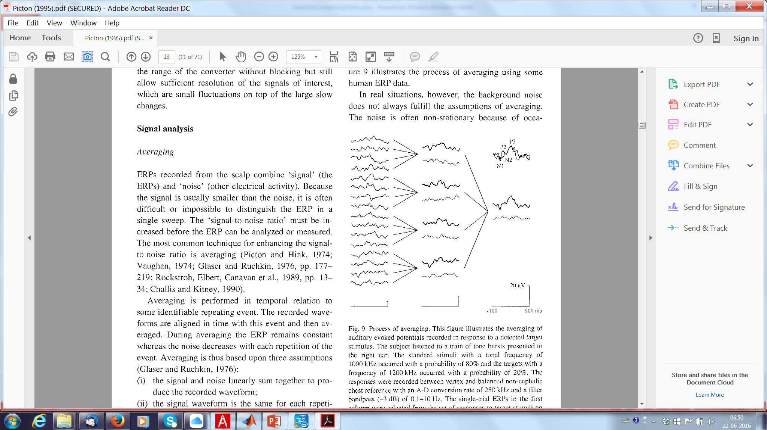
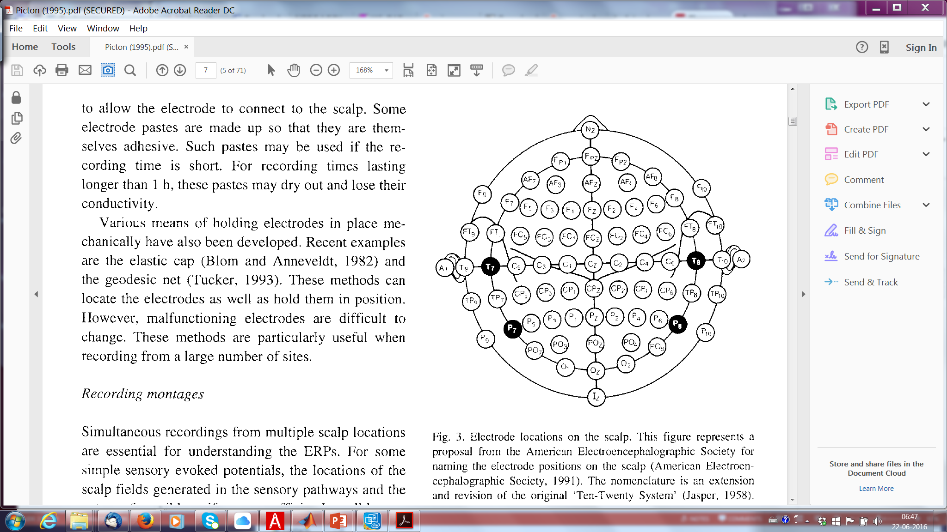
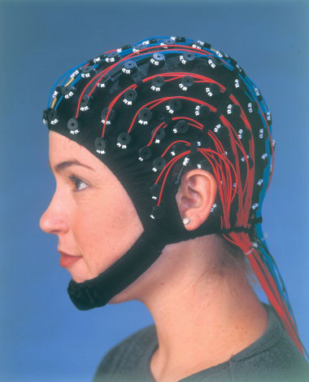
ERP averaging
Picton et al 1995

Slide 13
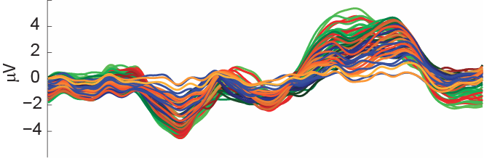
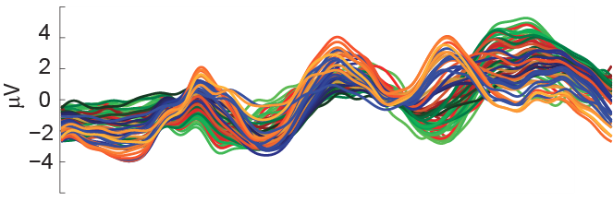
P300 wave - oddball
Talwar et al (in progress)

Slide 14
Issues with ERP
Cancellation of components due to jitters: biological or measurement noise
Amplitudes scales with n (sample size)

Slide 15
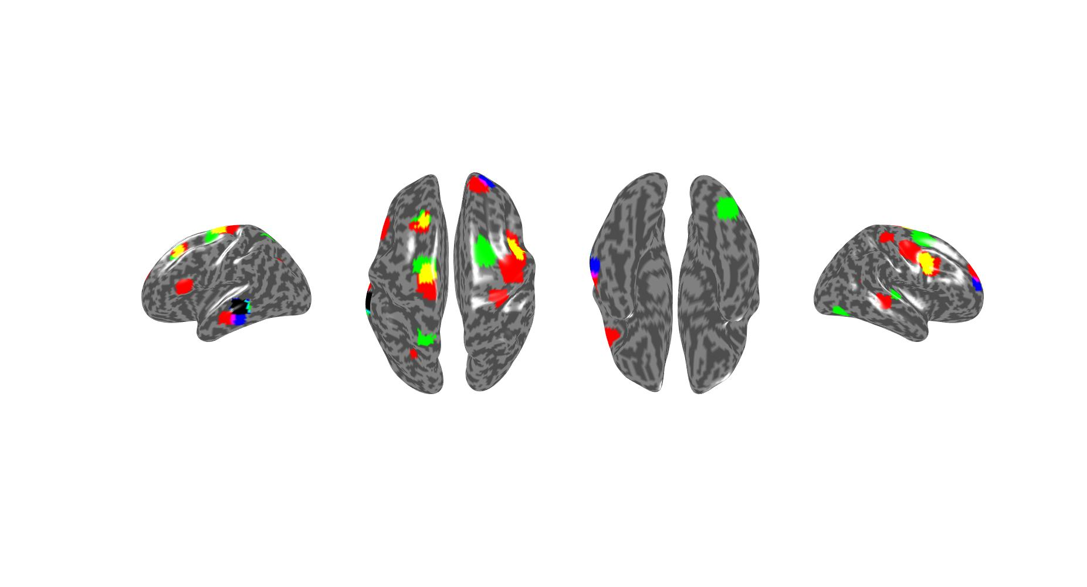
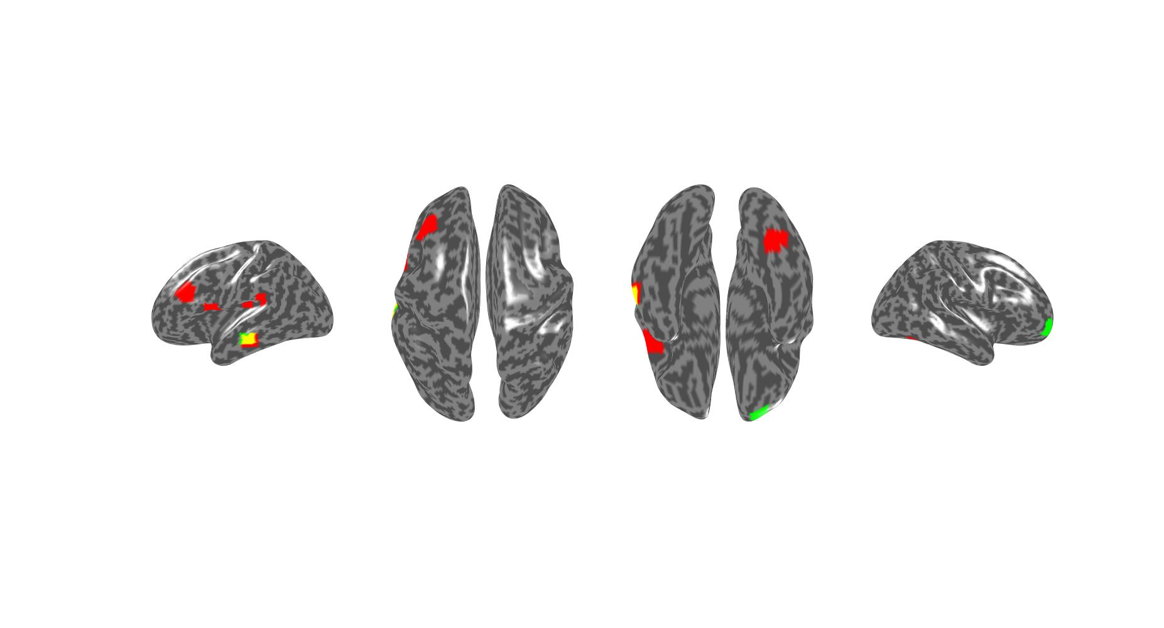
Sources underlying ERP
Audio c&d
Audio b&c
Audio a&b&c
Audio a
Audio b
Audio a&b
Audio b&c
Audio a&b&c
Visual b
Visual b&c

Slide 16
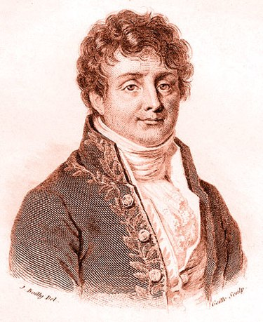
Brain oscillations
Joseph Fourier – Dude from three centuries ago
Discrete Fourier transforms
Multi-taper estimates

Slide 17
Induced vs evoked power

Slide 18
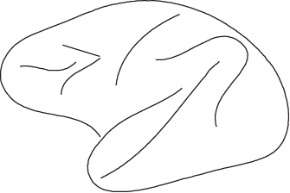
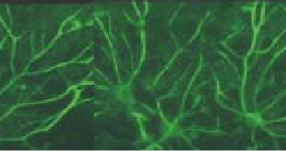
The problem of connectivity
Information processing occurs in distributed brain network during ongoing behavior. Simultaneously activated networks can be functionally connected if their activity is statistically inter-dependent over time.
Input

Slide 19
Major classification of connectivity measures
Non-parametric measures (Model free). No explicit models are required.
Ex: Correlation, Coherence, Partial Coh, Relative phase
Pros: Not committed to a model, Cons: General statements, inference requires hypotheses ~ models
Parametric measures (Model based) “Effective Connectivity”
Ex: Chronometry, Cognitive subtraction and MLCS,
DCM, Granger.
Pros: Specific questions can be answered with suitable statistics (if available), Cons: Results dependent on choice of model, Hence different paradigms may require different models
Friston 1994
Horwitz 2003

Slide 20
Classifications based on “what is measured across 2 or more areas”
Linear relationships (coupling) among information processing modules
Non-linear relationships (coupling) among information processing modules
Directionality of information flow

Slide 21
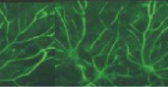
Non-parametric measure
Measuring linear relationships (time domain)
Cross correlation (Bivariate)
Assuming stationarity
Partial correlation (Multivariate)
Andersen, T. W: An Introduction to Multivariate Statistics

Slide 22
Non-parametric measure
Measuring linear relationships (frequency domain)
Cross coherence (Bivariate)
is the spectrum of
Partial coherence (Multivariate)
Percival & Walden 1993

Slide 23
Communication though coherence

Slide 24
Concept: Resting vs task
Time averaged correlations and coherence across frequencies assume stationarity of the signal within the observed time window. For measuring functional connectivity during resting state this is ok. But we can relax this assumption to quantify functional connectivity during task by implementing time-frequency measures.
Time frequency spectrogram using a wavelet transform
where Morlet wavelet equals,
Daubechies, I. 1990

Slide 25
Non-parametric measures
Measuring linear relationships among non-stationary signals (time-frequency)
Wavelet coherence (Bivariate)
SW is the wavelet transformed spectral matrix
Partial wavelet coherence (Multivariate) Yet to be applied and developed
Lachaux, et al 2004

Slide 26
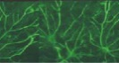

Parametric measure 4
Granger causality
Granger, C 1969
Kaminski, M et al 2001

Slide 27
Parametric measure
Coupled oscillator entropy
Cross dependency
Directionality index (0: bidirectional symmetric)
1: For x y
-1: For y x
Rosenblum & Pikovsky 2001

Slide 28
Summary: Connectivity measures
Functional
Effective
Linear
Nonlinear
General
Linear
Nonlinear
General
Rel phase
distbn
Mutual
information
DCM
Coupled oscillator entropy
Chronometry
CS & MLCS
DCM
DTF
Stationary
Non-stationary
Correl/ Partial
Coherence/ Partial
Wavelet coherence
Partial wavelet coh
Stationary
Non-stationary
SEM
Granger
DICS
TF
(based on Wavelets)

Slide 29
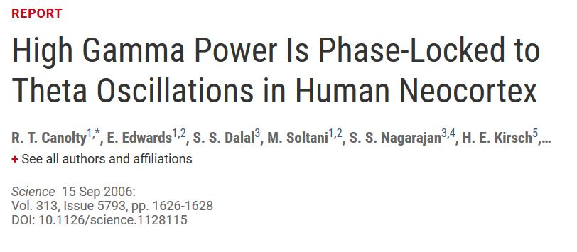
Phase-amplitude cross-frequency coupling

Slide 30
Where are we going with EEG
Cole and Voytek 2017

Slide 31
Neuromarkers of social coordination (phi rhythm)
Tognoli et al 2007

Slide 32
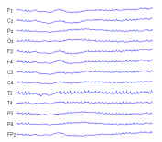
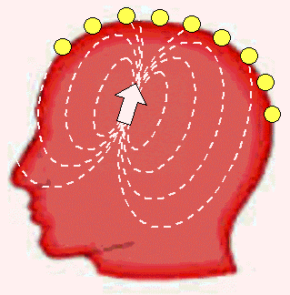
Source analysis: Why it is so challenging?
Smearing and distortion
32

Slide 33
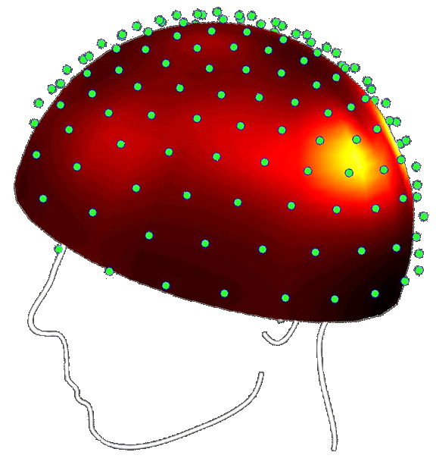
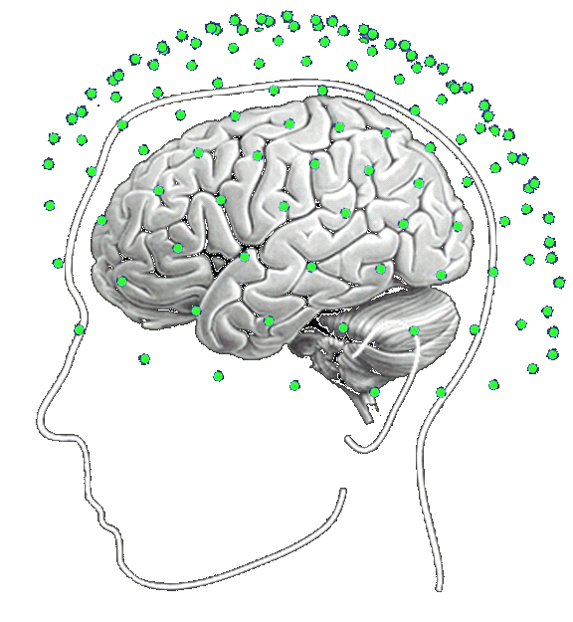
Inverse Problem
Forward problem (well-posed)
Data Y
Inverse problem (ill-posed)
Current density J
33

Slide 34
The electrostatic forward problem (1shell, multishell)
Multishell model

Slide 35
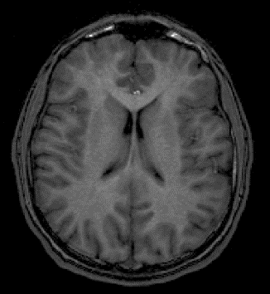
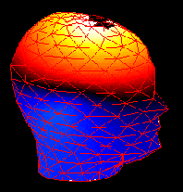

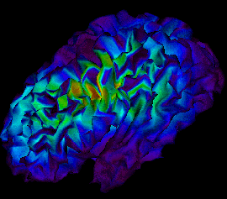
How We Deal with Inverse Problem
Setting up Assumptions(Constraints)
Two Basic Approaches
A. Discrete Source Analysis
B. Distributed Source Analysis
Anatomical
constraints
Final Product: Reconstructed Source
ill-posed inverse problem
EEG/MEG
Data
Functional
constraints
35

Slide 36
Constraints Assumptions about the nature of the sources
Three Types of Constraints:
1. Mathematic Constraints( e.g., minimum norm, maximum
smoothness, optimal resolution, temporal independence)
2. Anatomical Constraints (e.g., Normally use the subject’s MRI scan, if not, it is possible to use standardized MRI brain atlas (e.g., MNI) can be be warped to optimally fit the subject's anatomy based on the subject's digitized head shape.)
3. Functional Constraints e.g., Coherence (DICS), correlation (SAM)
36

Slide 37
Dynamic imaging of coherent sources (DICS)
D
where
y
x
Source coherence
Gross et al 2001

Slide 38
Highly recommended methods papers

Slide 39
Problem for the future
Relationship between ERP and spontaneous oscillations
Traditional approach: ERP is a transient response (input arriving at a particular location)
Somewhat acknowledged possibility: a stimulus reset the phase of endogenous oscillations
The provocative proposition: slow cortical components e.g. CNV are resulting from amplitude asymmetry (Mazaheri & Jensen, 2010)

